Slide 1

MeshCentral
Multi-Domain Servers

Slide 2
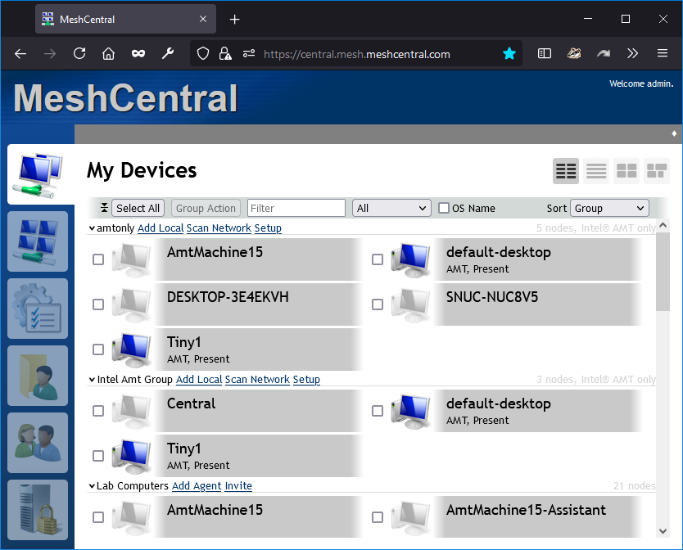
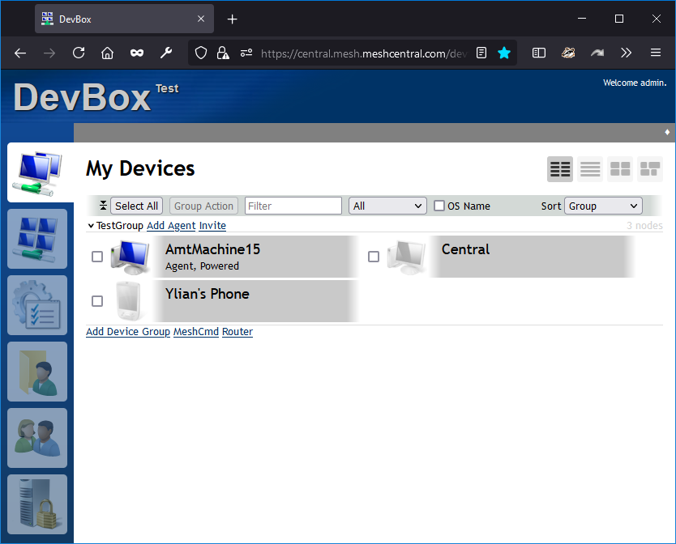
{
"settings": {
"cert": "maindomain.com",
"port": 443,
...
},
"domains": {
"": {
"title": "MeshCentral",
...
},
"customer": {
"title": "DevBox",
...
}
}
}
MeshCentral
https://maindomain.com
https://maindomain.com/customer

Slide 3
{
"settings": {
"cert": "maindomain.com",
"port": 443,
...
},
"domains": {
"": {
"title": "MeshCentral",
...
},
"customer": {
"dns": "customer.com",
"title": "DevBox",
...
}
}
}
MeshCentral
https://maindomain.com
https://customer.com

Slide 4
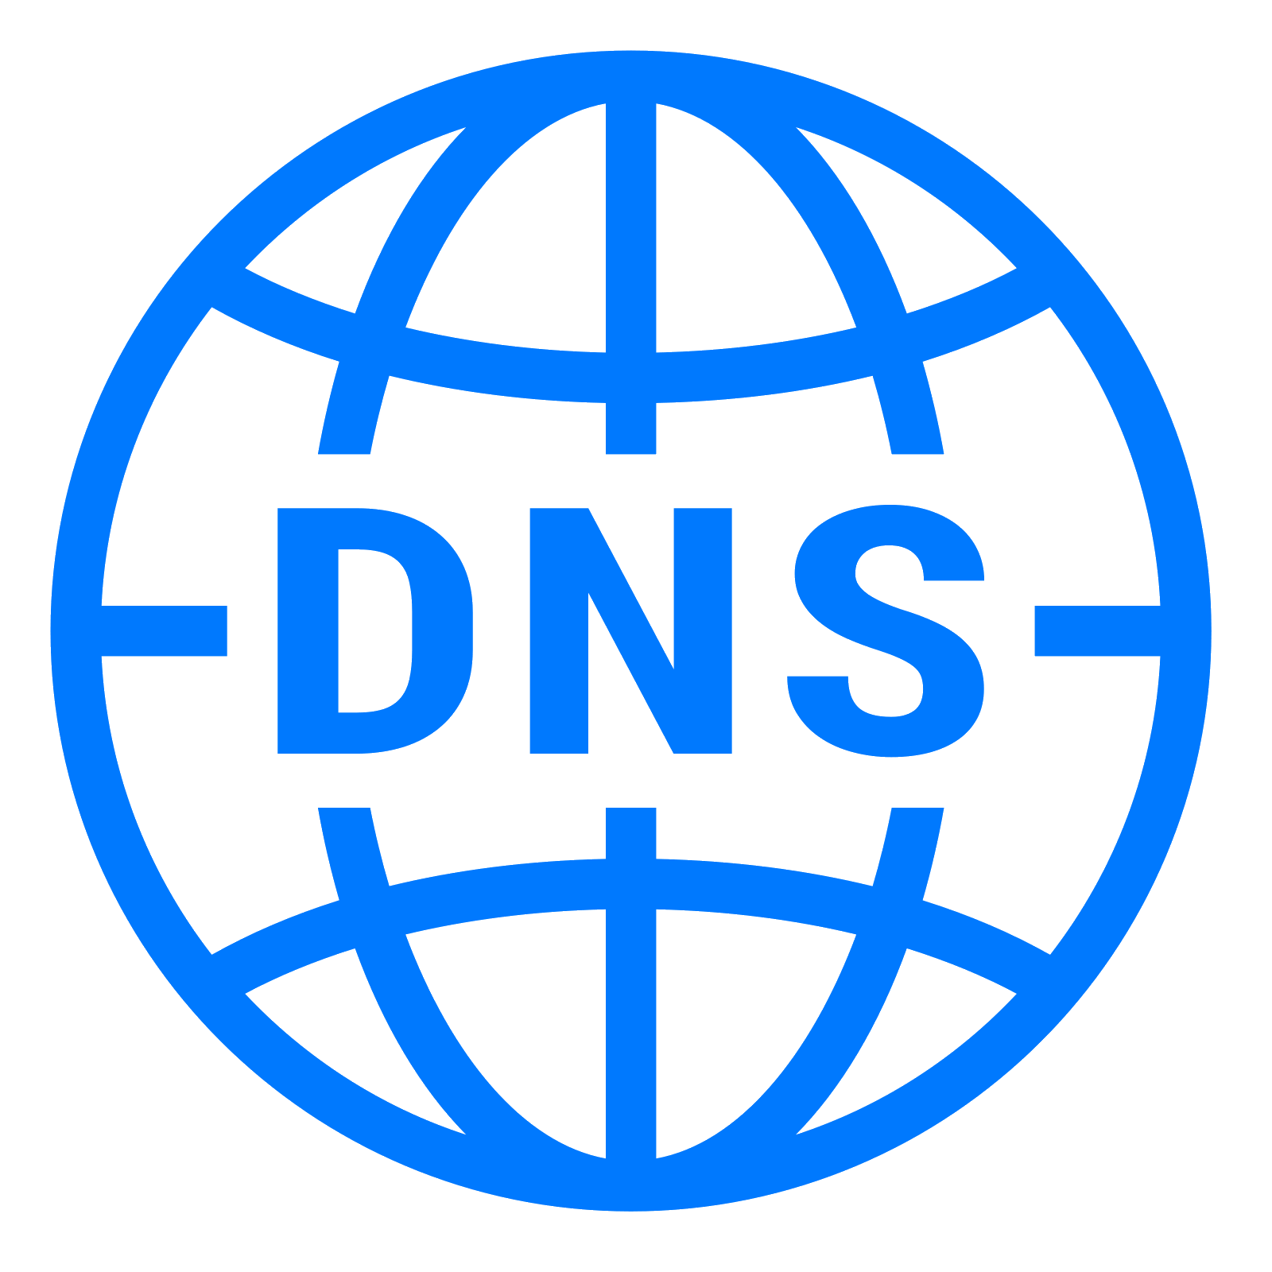
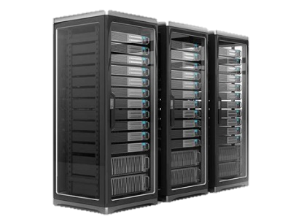
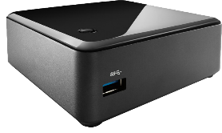
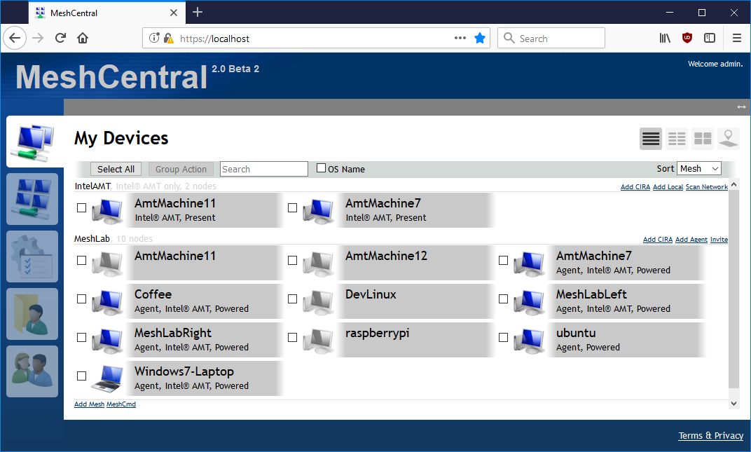
maindomain.com
customer.com
Public IP address
x.x.x.x
MeshCentral

Slide 5


MeshCentral
maindomain.com
customer.com
Private IP address
y.y.y.1
Reverse Proxy
File Server
Public IP address
x.x.x.x
Private IP address
y.y.y.2
Ports 80 and 443
are shared.
Web Server
Private IP address
y.y.y.3

Slide 6
user//admin
nesh//abcdefg…
node//abcdefg…
ugrp//abcdefg…
{
"settings": {
"cert": "maindomain.com",
"port": 443,
...
},
"domains": {
"": {
"title": "MeshCentral",
...
},
"customer": {
"title": "DevBox",
...
}
}
}
user/customer/admin
nesh/customer/abcdefg…
node/customer/abcdefg…
ugrp/customer/abcdefg…

Slide 7
{
"settings": {
"cert": "maindomain.com",
"port": 443,
"ManageCrossDomain": [
"user//admin",
],
...
},
"domains": {
"": {
"title": "MeshCentral",
...
},
"customer": {
"dns": "customer.com",
"title": "DevBox",
...
}
}
}
Allow management of users across domains.

